Slide 2

1
1
Lesson 11
Factor and Multiple I

Slide 3
Part 1
Factor and Multiple Basic

Slide 4
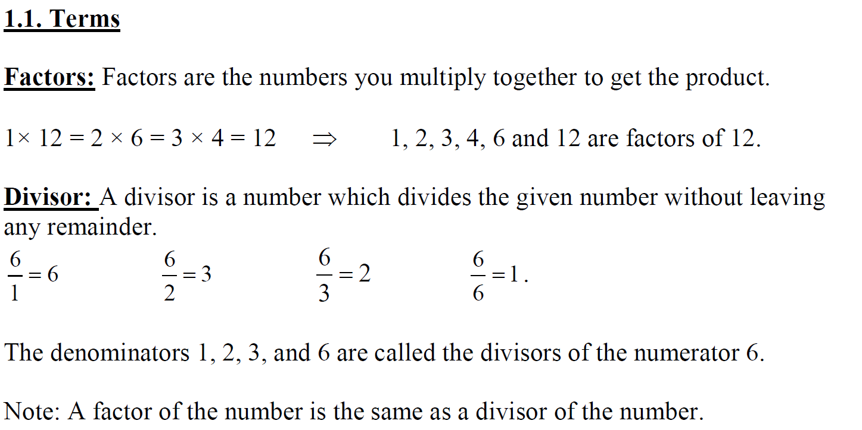
Lead in

Slide 5
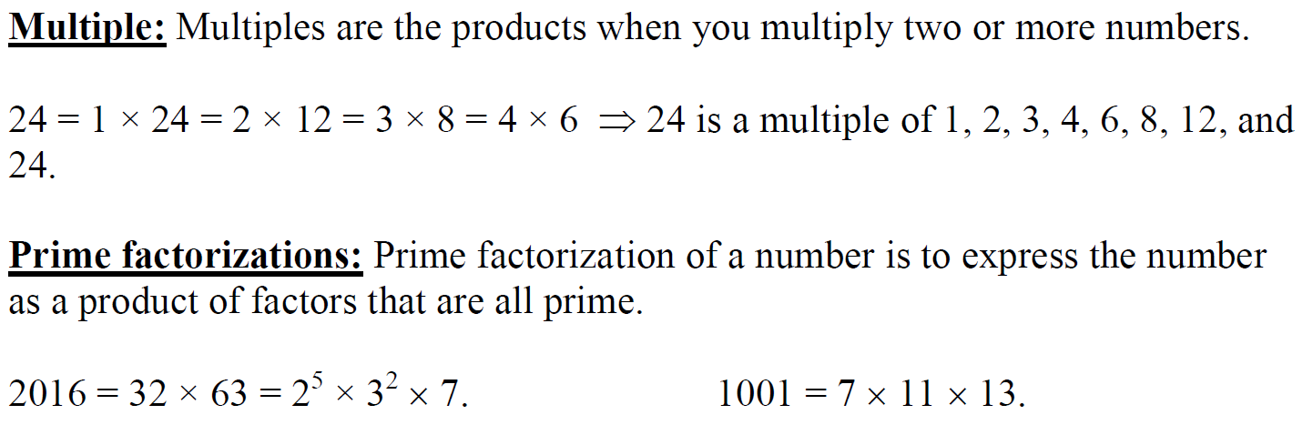
Lead in

Slide 6
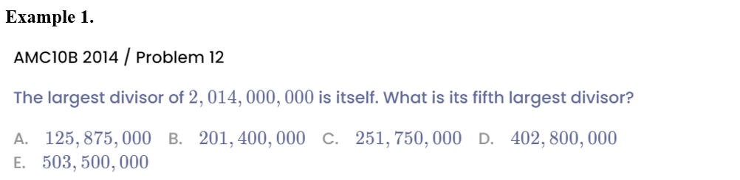
Example

Slide 7
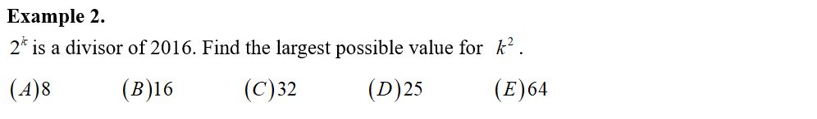
Example

Slide 8
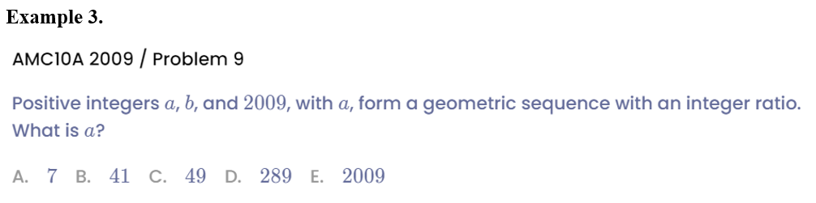
Example

Slide 9
Part 2
Factor of Perfect Cube

Slide 10
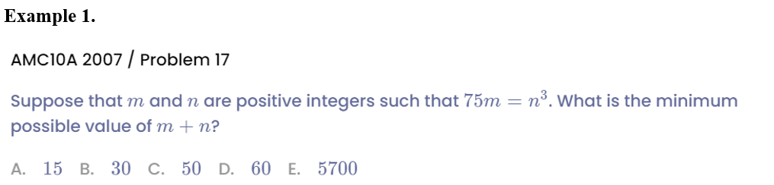
Example

Slide 11
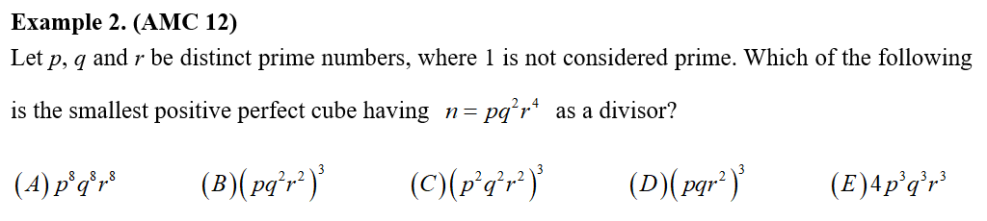
Example

Slide 12
Part 3
LCM & GCF

Slide 13
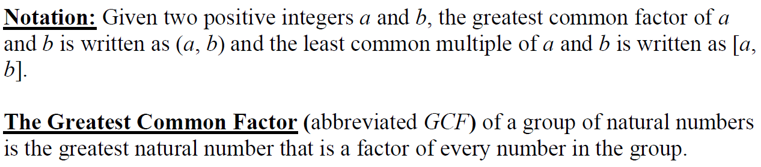
Lead in

Slide 14
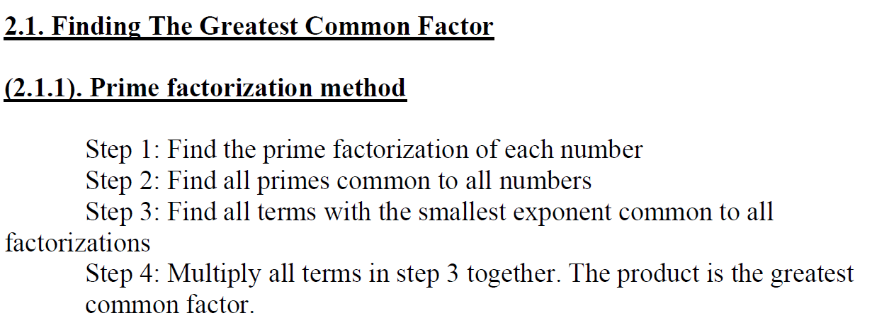
Lead in

Slide 15
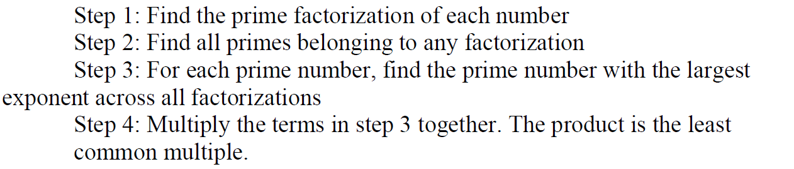
Lead in

Slide 16
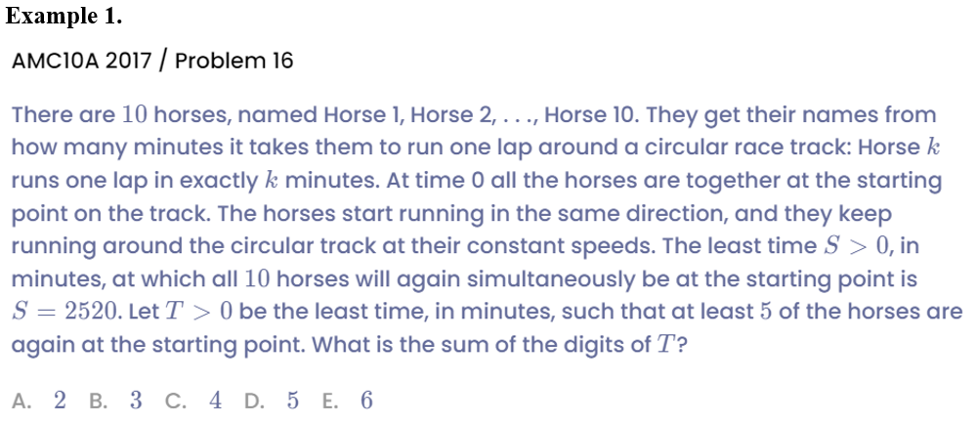
Example

Slide 17
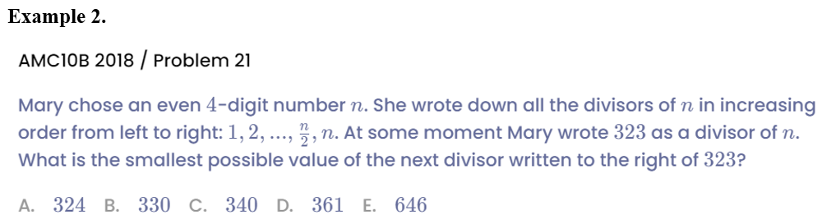
Example

Slide 18
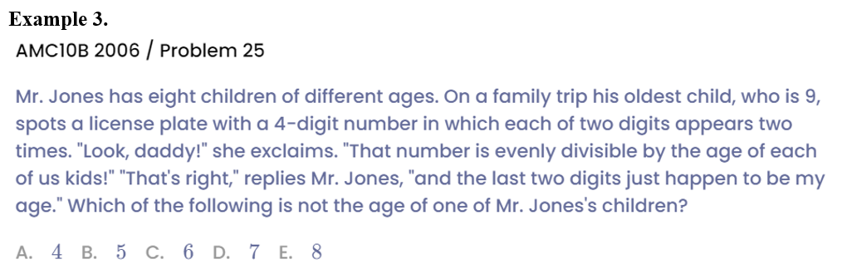
Example

Slide 19
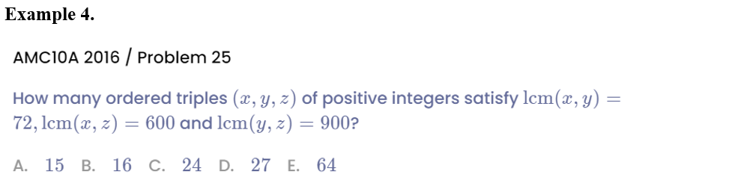
Example

Slide 20
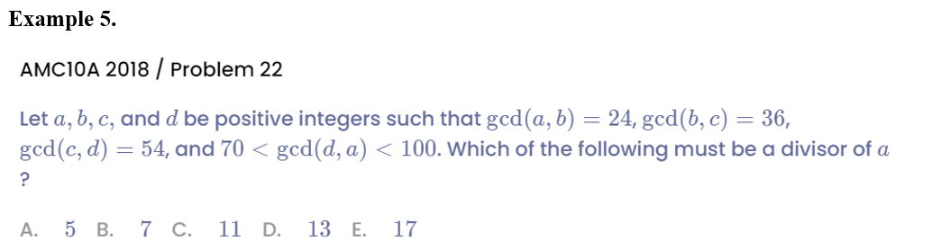
Example

Slide 21
See You Next Time!

